Slide 1

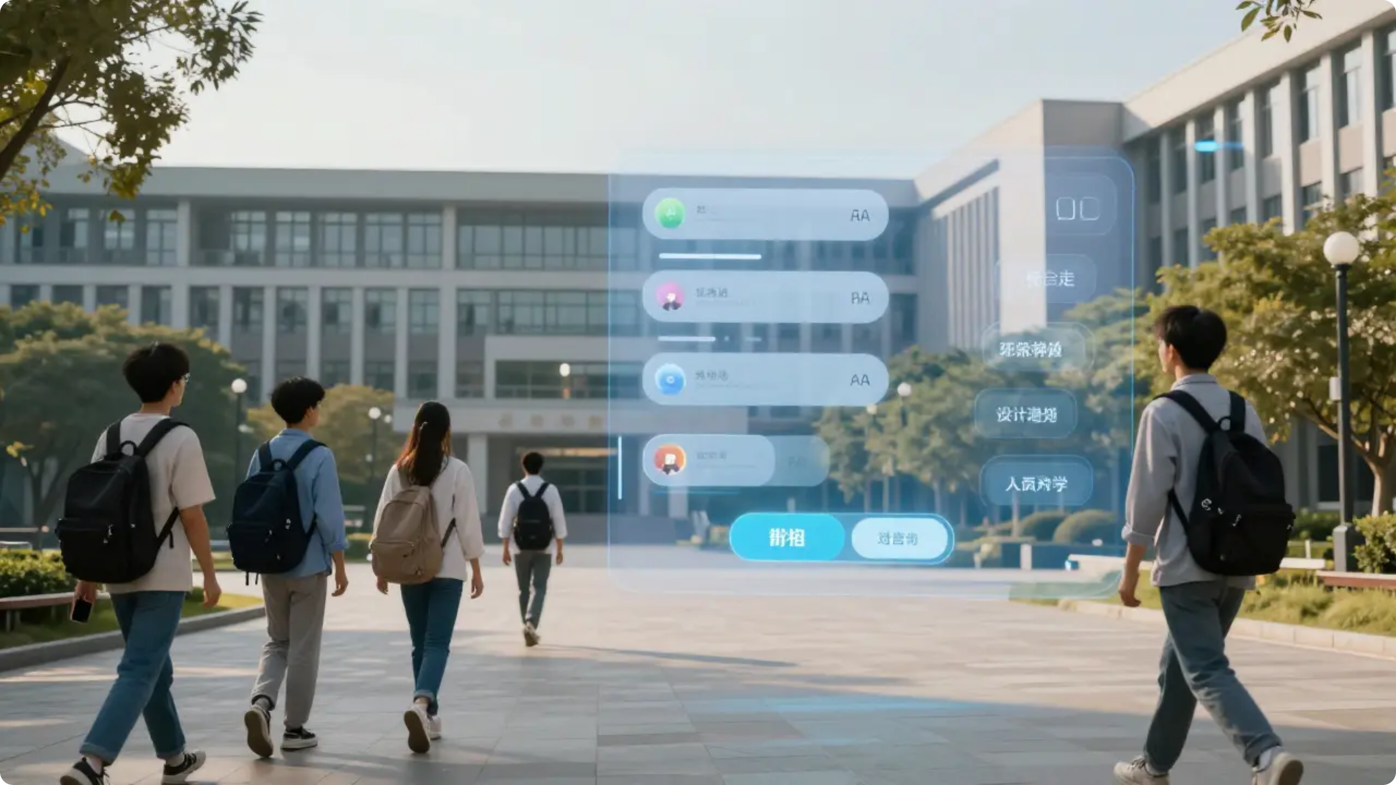

UCSI Buddy Chatbot
UCSI Smart Web Page Chatbot
Team RobinHood

Slide 2

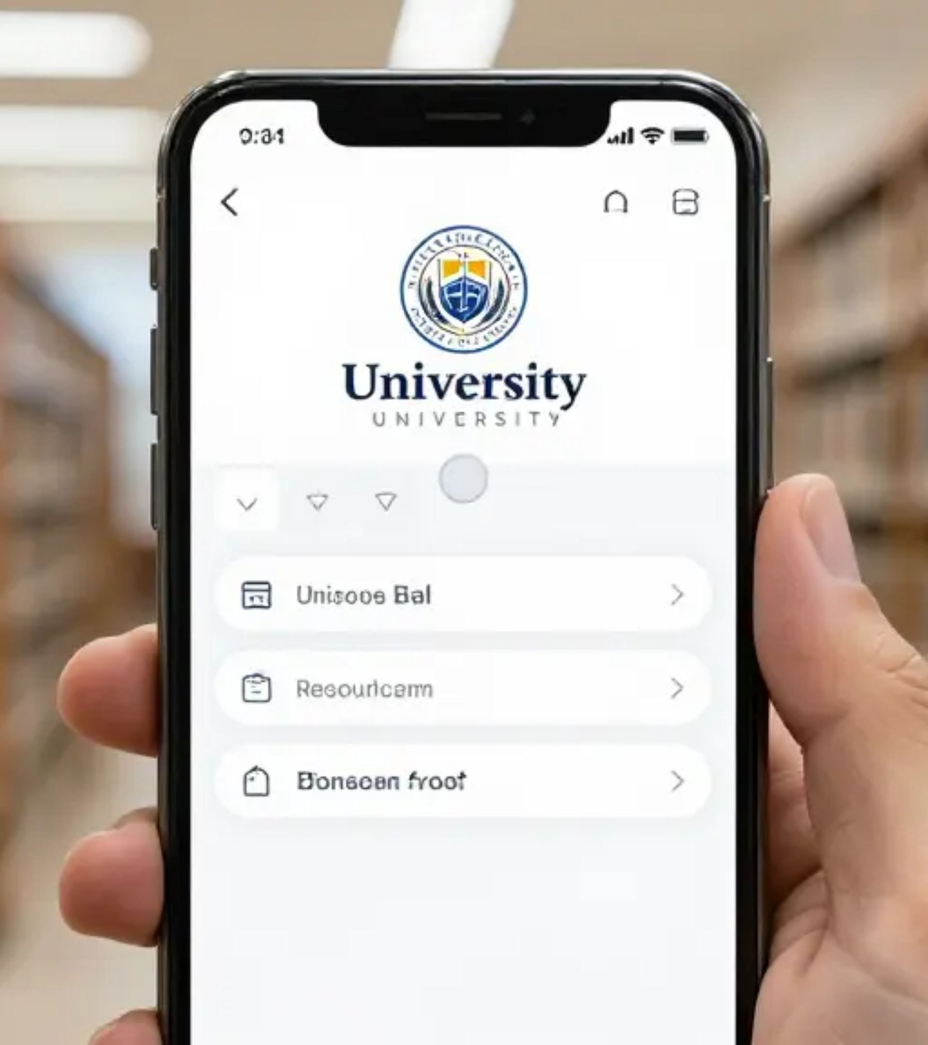

PROJECT INTRODUCE
CONCEPT
Web-page Chatbot Buddy
CORE
Make easier for student to find relevant information in UCSI

Slide 3






PROJECT OBJECTIVE
Goal 1 [Security]
Goal 2 [Visual]
Goal 3 [Growth]
Easy to see with photos and links
Getting better with user feedback
Protecting student information
with dual authentication

Slide 4

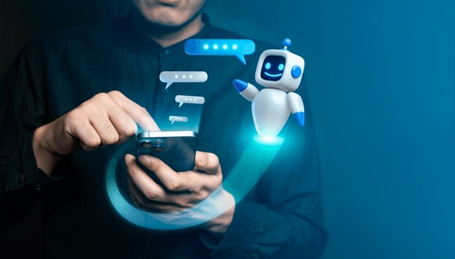
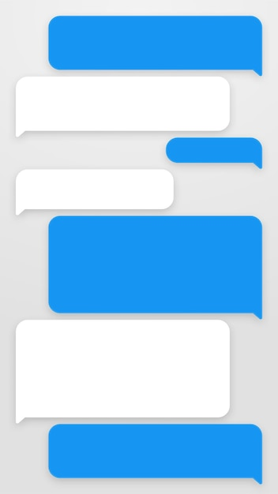

KEY FUNCTION
Like Button
Smart Questions
Photos and Links
Getting smarter with your likes and feedback
Suggesting more questions
Building photos and quick official links

Slide 5









Tech Stack
HTML/JS/CSS
FastAPI
Google Gemma
MongoDB
Tailwind CSS
Python 3.13
FAISS

Slide 6


















Our Team
Robin
Bed
MICOL
Project Manager Manage Project and Build Server Environment
Lead Developer System Architecture Design & Full-stack Develop
AI Logic Engineer Make AI self learning system and make smarter
Bibi
Su
Erica
DB Engineer Manage student and UCSI data
Data Platform Engineer Collect school and major data
UI/UX Engineer Design the web page and Chatbot

Slide 7
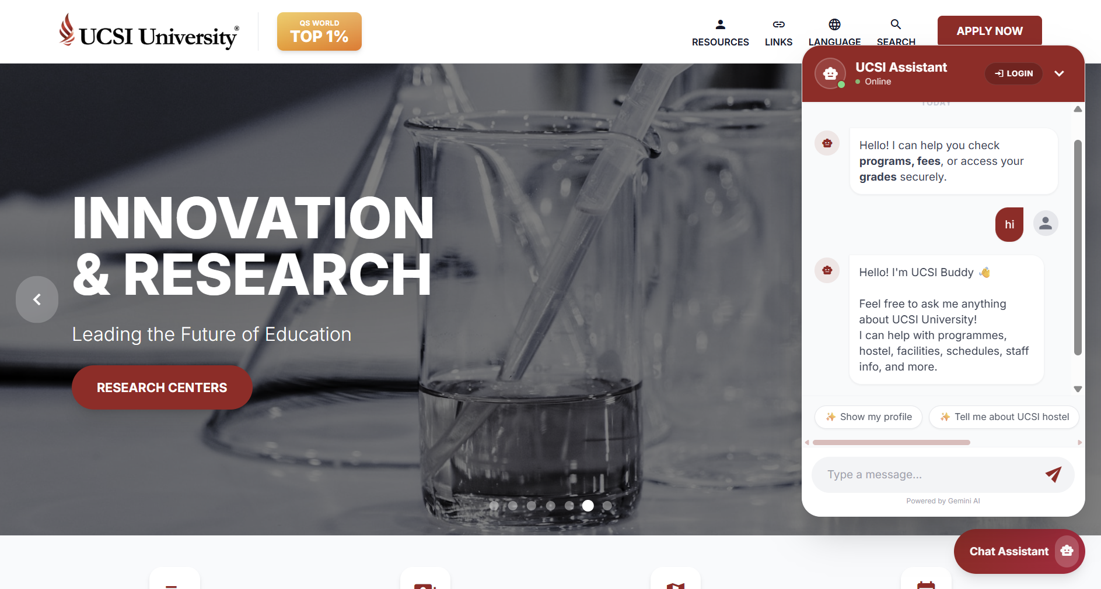
Front-end & UI/UX

Slide 8
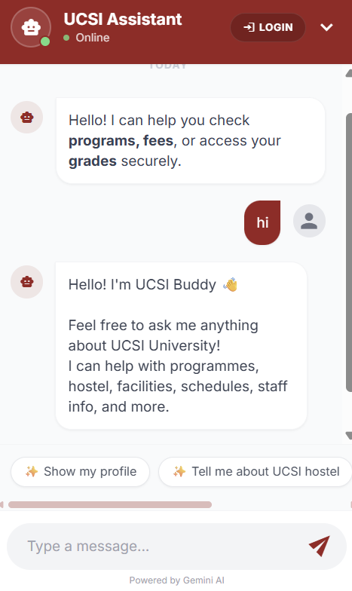
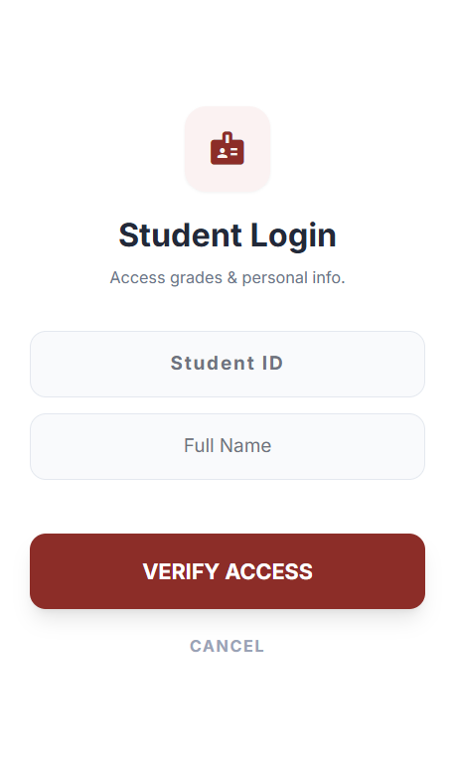
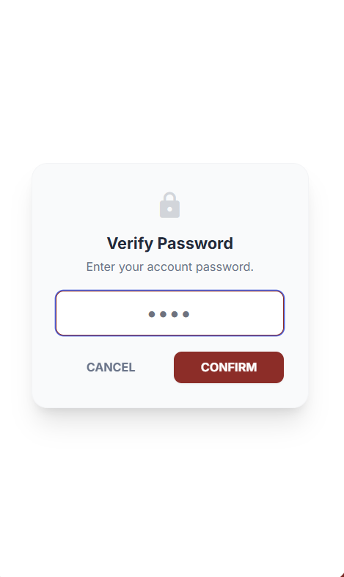
Front-end & UI/UX

Slide 9
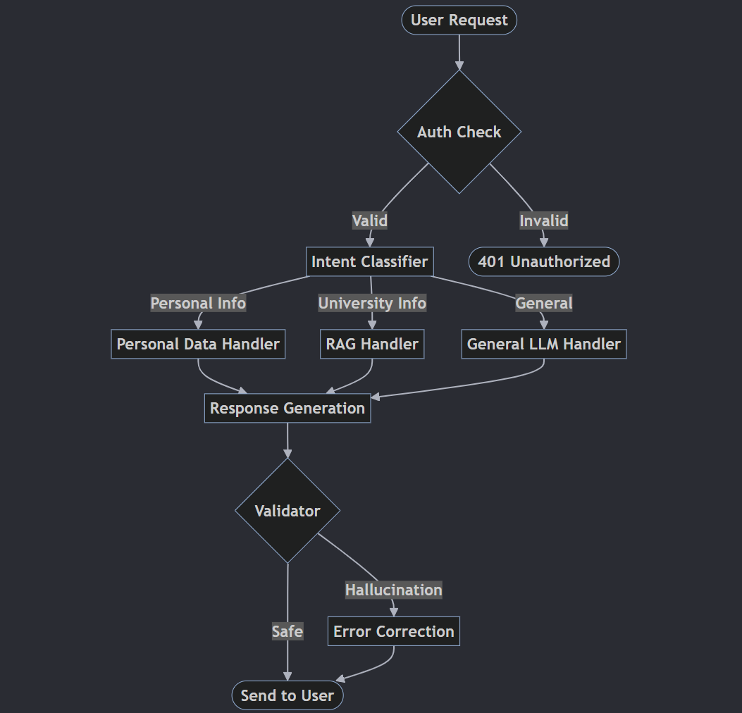
Architecture
Classification by Question Intention

Slide 10
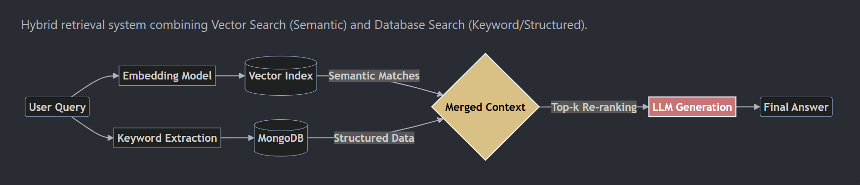
RAG Pipeline
The use of hybrid methods

Slide 11
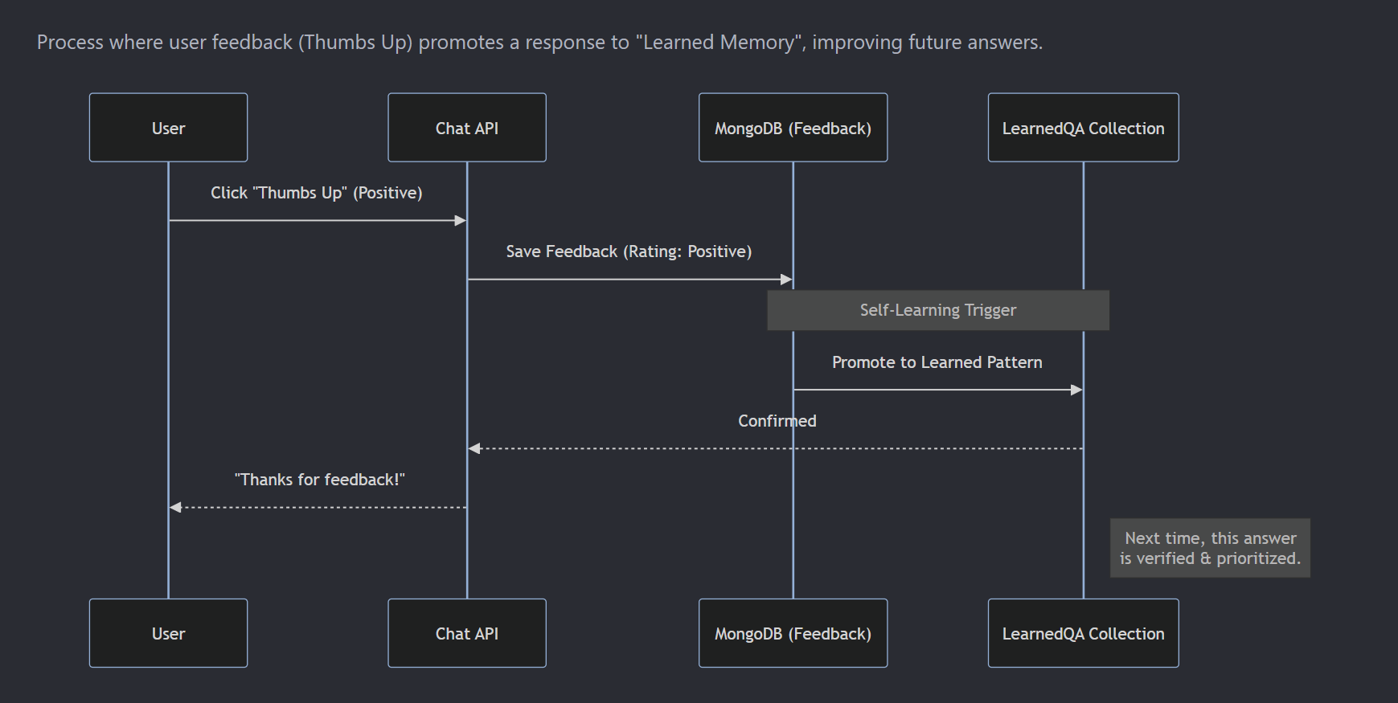
Feedback System
How Self-Learning Works

Slide 12
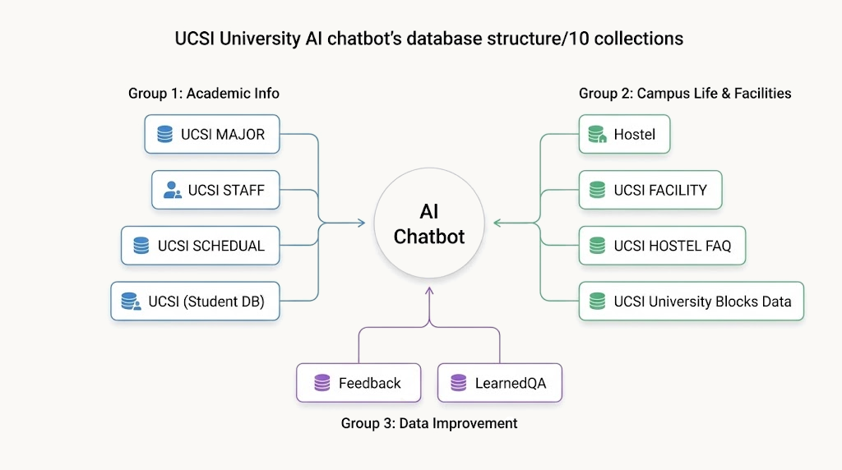
Database

Slide 13
DEMO

Slide 14






Conclusion
"Your Smartest Campus Friend, Buddy"
Safe Information
Helpful Guide
Getting Smarter
3-step security keeps data safe
Photos, links, and suggestions
Self-learning system improves every day

Slide 15
Q&A

